Slide 1






April 7th, 2020
PM: Hunter
Frontend: Annie, Ashwin, Kevin Cheng,
Kevin Lee, Neha, Nicholas
Backend: Alex, Joe Chu
Notes:
Hunter
Hello everyone! We are Poll Buddy. I’m Hunter, the project manager, and I’m going to start us off by giving an overview of our app and how we’re developing it, and later you’ll hear from other Poll Buddies some more in depth details relating to the front and back ends of the project.

Slide 2
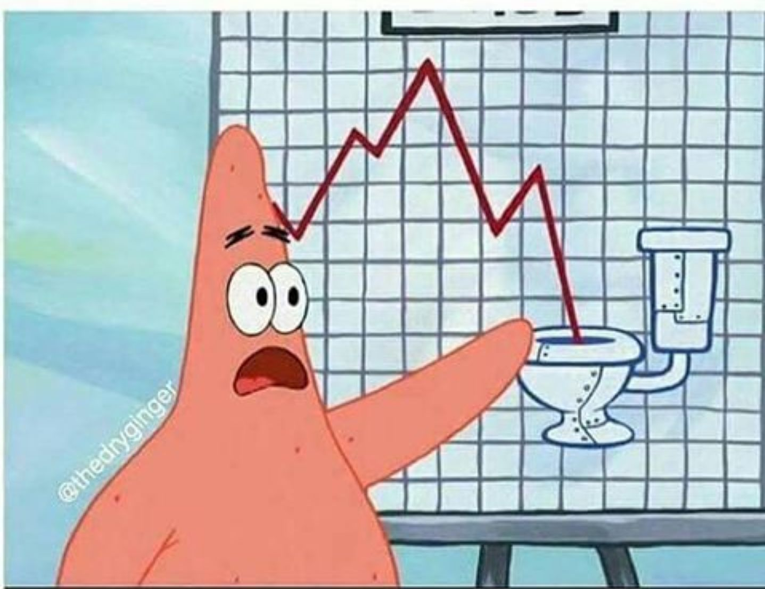

What is Poll Buddy?
Website alternative to iClickers
“Virtual Classroom”
Affordable, easy-to-use, and interactive
Customizable teacher and student views
Integratable with Submitty and other RPI platforms
Notes:
Hunter
Poll Buddy is basically a website alternative to iClickers. iClickers are classroom tools used to get responses from students, but they have some major limitations. We want to build a virtual classroom system that’s affordable, easy to use, and interactive and offer customizable views for both teachers and students. We also aim to integrate with Submitty and other RPI platforms for things like easy automatic grading and simple sign in.

Slide 3
PollBuddy Info
Time goal of the project: minimum viable product by next semester
Repo: https://github.com/PollBuddy/PollBuddy
License: MIT
Contributors: Anyone can access the GDrive folder of resources from the repo. Github issue list gives potential tasks to work on. Readme files and Contributing Guides planned.
Notes:
Hunter
We’re aiming to have this ready for professors to try out over Arch, but we’ll obviously evaluate our progress beforehand as we don’t want to ship an unfinished project. Given the recent news that Arch will be taught remotely, this could be invaluable as iClickers cannot work without everyone being in the same location. Oh this slide, I’ve linked our repo page and that we’re using the MIT license. As for contributors, anyone is able to access our Google Drive folder with project resources, Github issues give an easy way to find something to do, and in the near future we’ll be expanding our documentation through more thorough readmes and contribution guides.

Slide 4
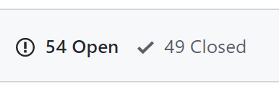
Managing the Project
Milestones were broken down into months and issues per month.
Issues used as trackers for todo items. Labeled frontend/backend/other as relevant.
Notes:
Hunter
We went with a simple system this semester of tracking to-do items through Github Issues, and linking them to milestones to group them by month to keep on a schedule. With the crazy twist in classes, this has been very helpful to manage the project.

Slide 5
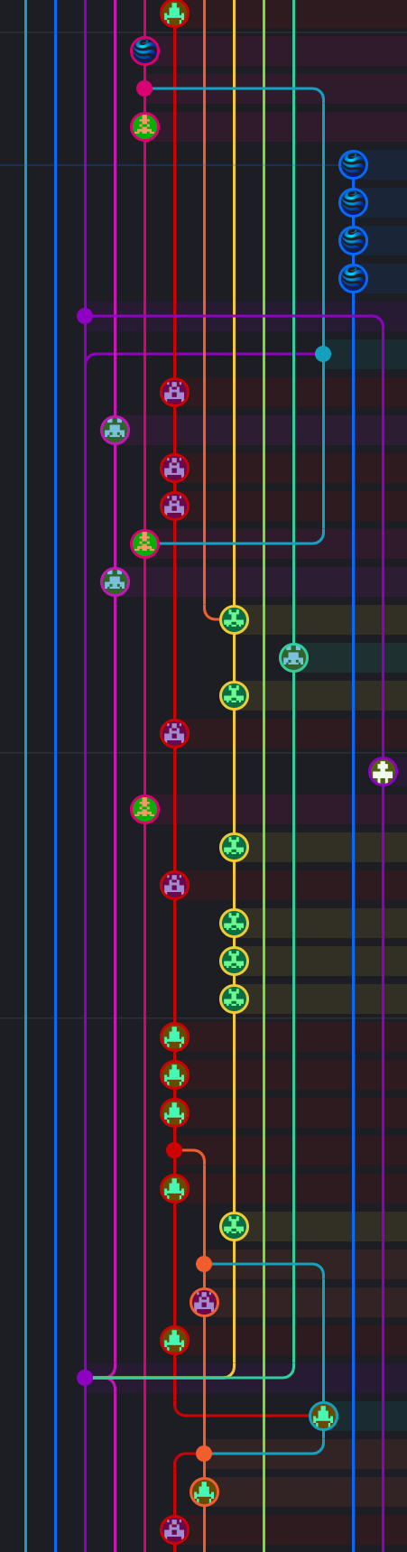
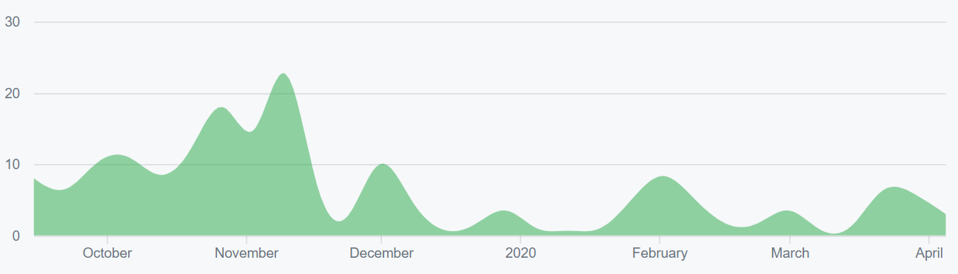
Repo Stats
248 total commits to master (as of 4/5/20)
Contributions to master, excluding merge commits:
Notes:
Hunter
Here are some basic stats about the repo. We’ve not added nearly as many commits as last semester (only up about 50) because of the big focus on design at the beginning of the semester that took place on Google Slides instead, but the commits are flowing in steadily now that development is underway. This also doesn’t take into account the various feature branches that currently exist and haven’t been merged yet, so this number is actually a fair bit higher.

Slide 6
Front End
Notes:
Hunter: And now I’d like to pass it off to Nick to talk about the frontend.
Presenter: Nicholas

Slide 7

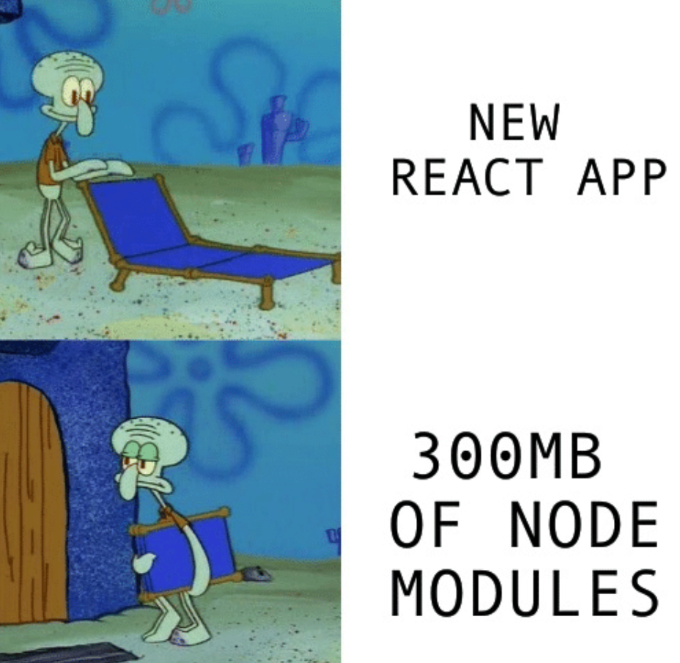

Frontend Framework
REACT!
Notes:
Presenter: Nicholas
We chose to use React as our framework for this project. We chose React because it allows for efficient code reuse with components. We also decided to use MDBReact which is a library of a bunch of pre made react components which look really nice and save us work on css styling

Slide 8
Past Frontend Milestones
Month of February:
Creating a new single logo
Creating a visually appealing color scheme
Creating new page designs and layouts in Google Slides
Month of March
Finalizing designs and choices from prev. Month
Beginning page code development
Notes:
Presenter: Kevin Lee

Slide 9
Style Guide
Created a style guide in order to keep all website colors uniform
Previously had inconsistent colors across all frontend pages
Info on font choices, appearances, etc
Created one unified logo
Notes:
Ashwin
Lots of different logos, color schemes and fonts at the beginning of the semester. Created a style guide to clean it up and crate uniformity.

Slide 10
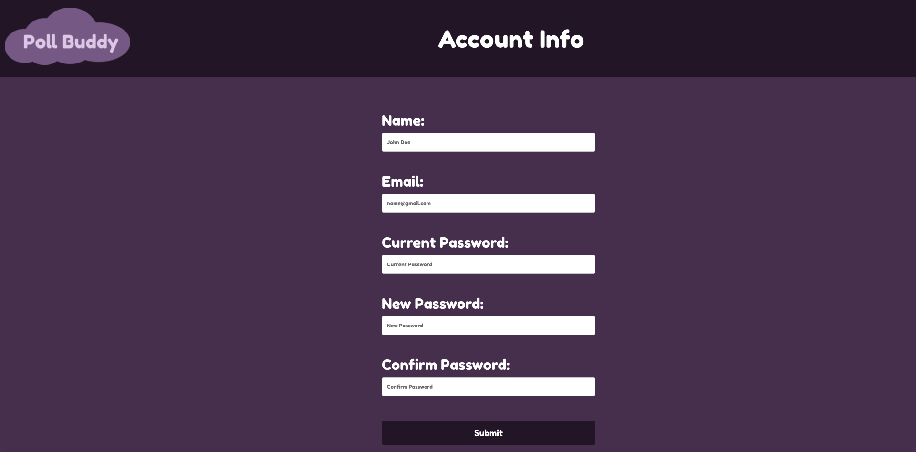

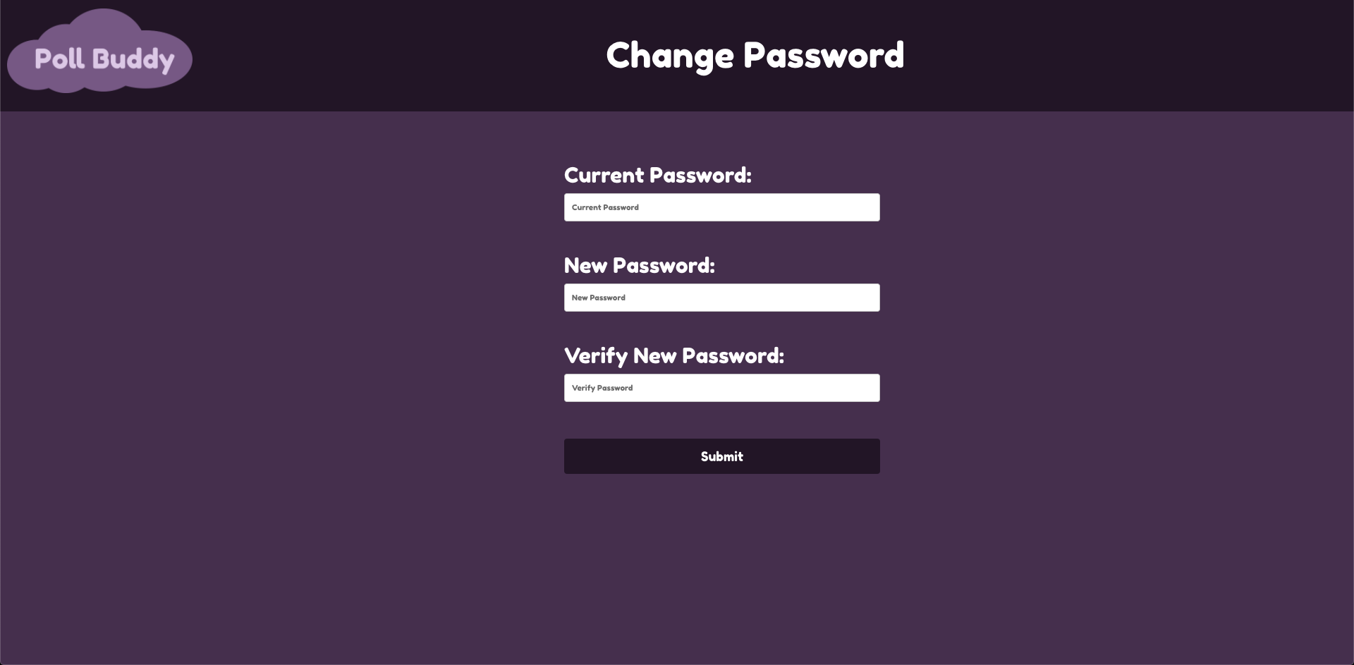

Account Info / Change Password
Notes:
Ashwin
Used HTML and CSS within React to create an account info page and change password page done using a simple form tag.

Slide 11
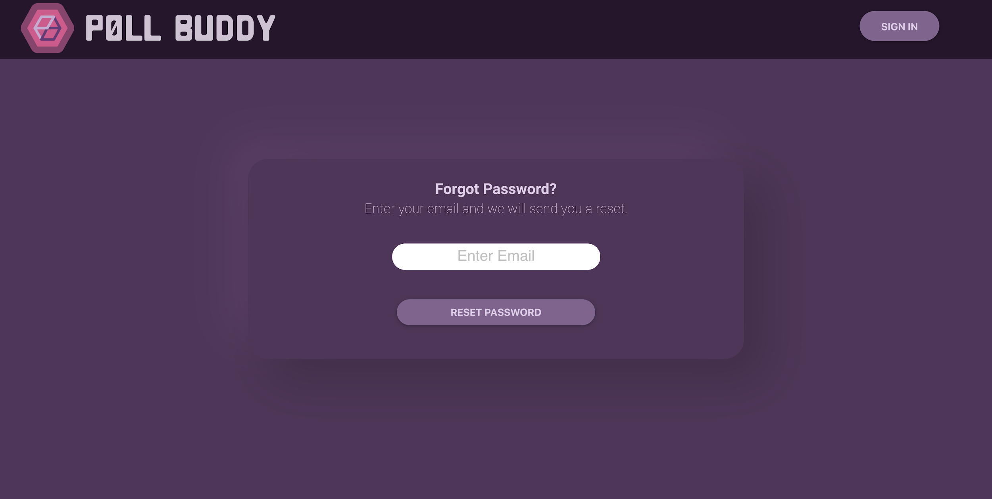
Forgot Password Page
Simple page for password reset
Notes:
Kevin Cheng
Using HTML and CSS, the forgot password page was created featuring a header and a prompt box to guide users to reset their password. The logo in the header will be changed to the agreed poll buddy logo.

Slide 12
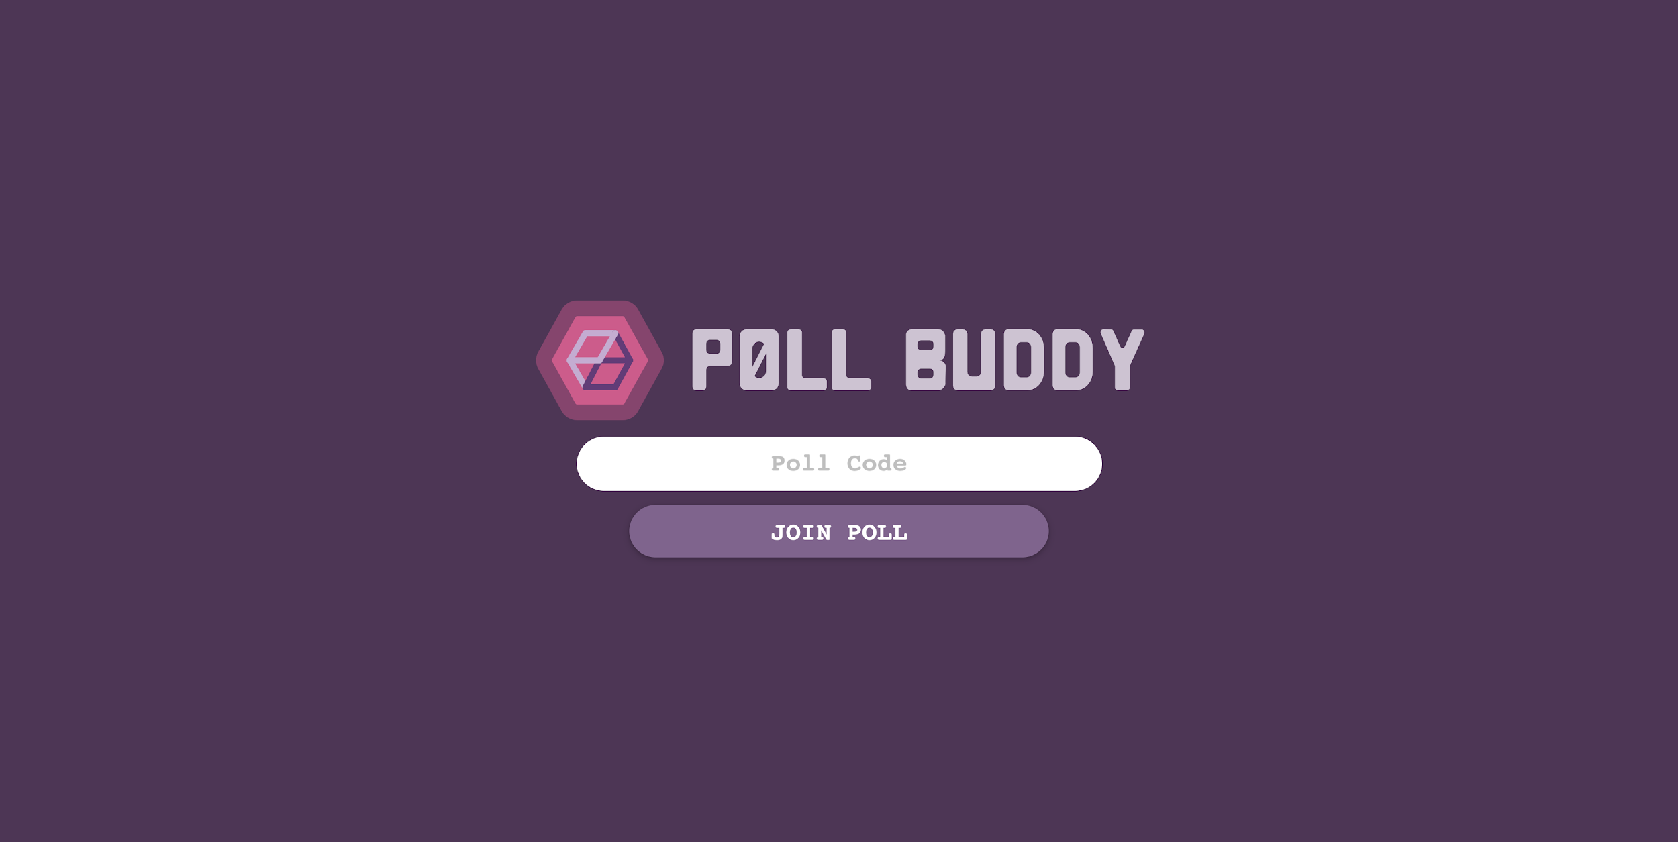
Poll Code Entry Page
Notes:
Kevin Cheng
A simple poll code page based on Kahoot’s game PIN page
Like the poll code entry page, the logo is going to be changed to the agreed Poll Buddy Logo

Slide 13
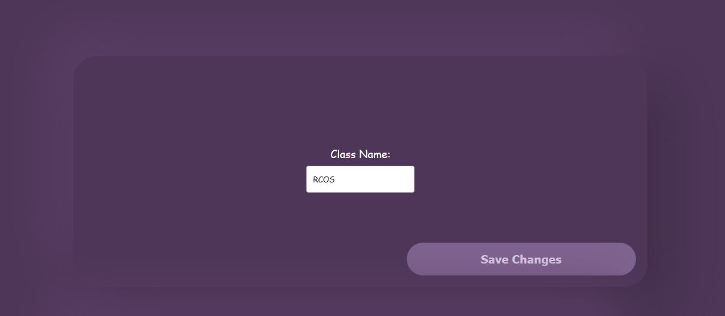
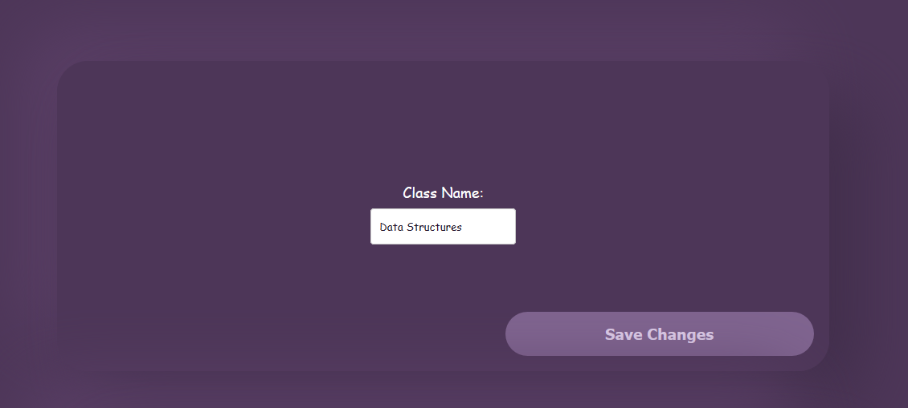
Class Editor Component
Allows user to edit class data
Currently only working with class name
Planned to support users, instructors, and lessons
Notes:
Presenter: Nicholas
I worked on the class editor component. The purpose of this component is to allow the user to edit a class that is existing. Classes consist of a name, a list of students, a list of instructors, and lessons. Right now, we only have functionality for editing the name of a class since we haven’t fully implemented students, instructors, or lessons yet. The class editor component also doubles as a class creation component so you can make a new class with it or edit an existing one.

Slide 14
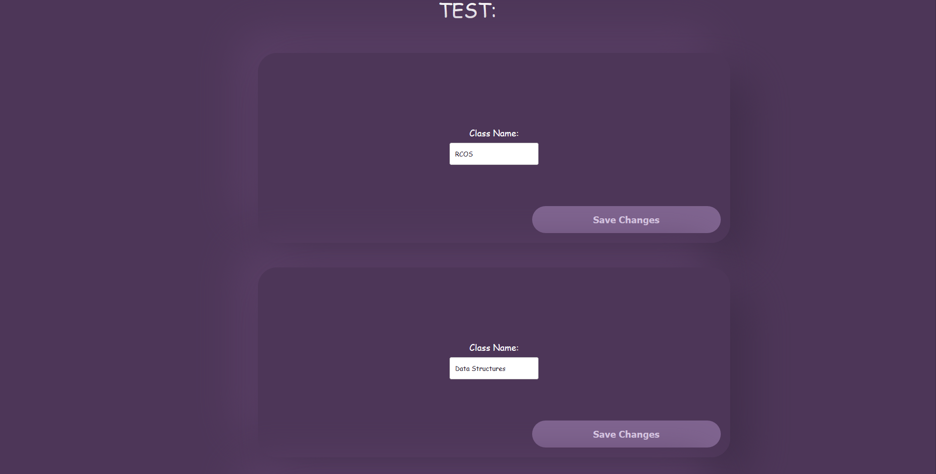
Template Page
Meant to demonstrate how to interact with the backend from the frontend using the class editor component as a demonstration tool
Notes:
Presenter: Nicholas
The template page is meant to show how to interact with the backend from the frontend for future developers. It uses the class editor component to read data from backend as well as edit it. If someone forgets how to connect to the backend, all they have to do is go to the template page and copy the code. This page will not appear on the final version of PollBuddy.

Slide 15
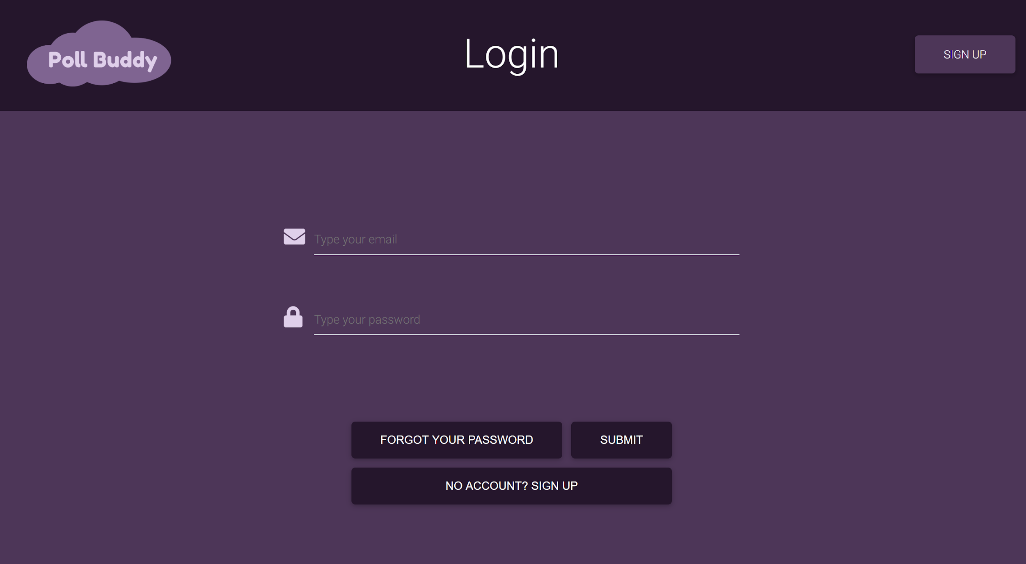
Login Page
Notes:
Presenter: Neha
Login page - One of the pages I worked on this semester was the login page, which I created using MDBReact, CSS, and HTML. The header has updated logo, places to input your email and password, and buttons to submit. There’s a forgot your password button for if you already have an account and a sign up button to register for an account.

Slide 16
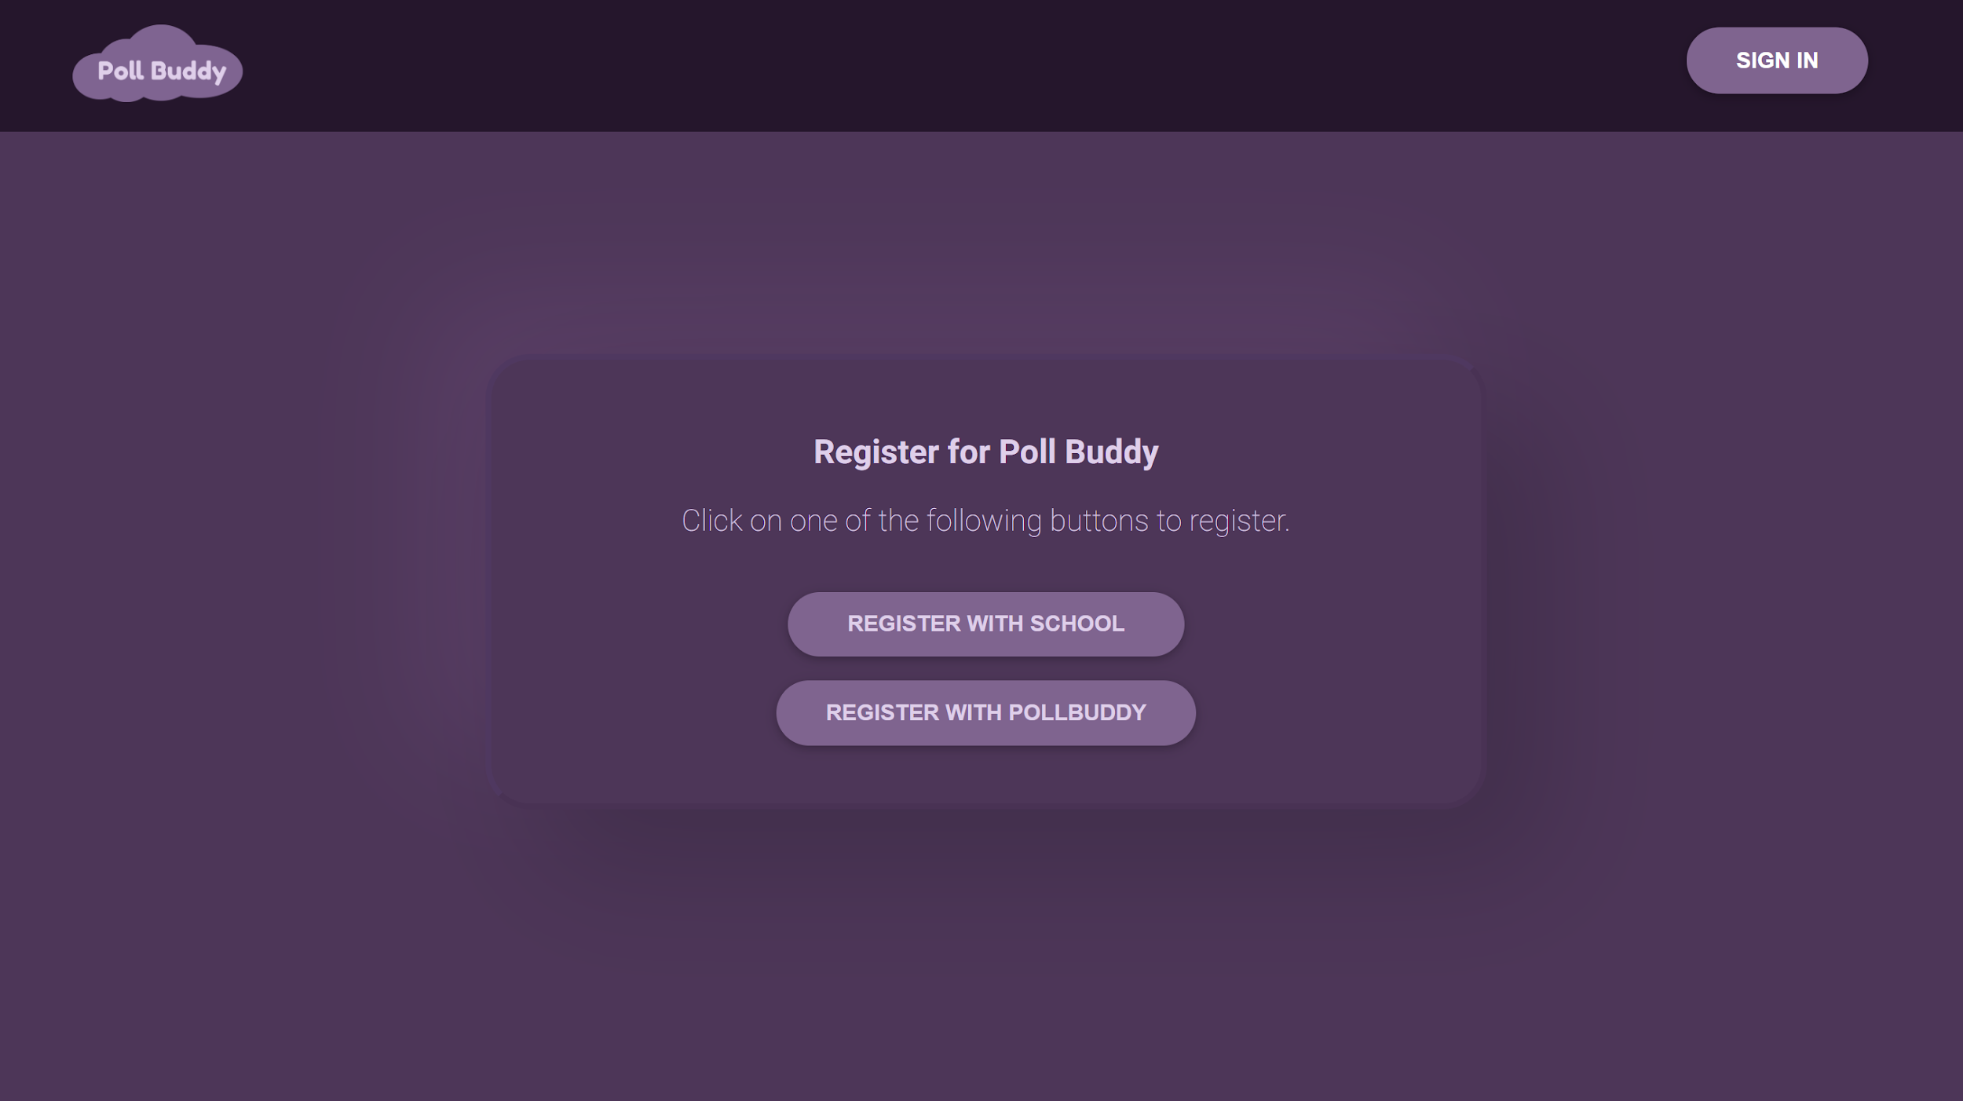
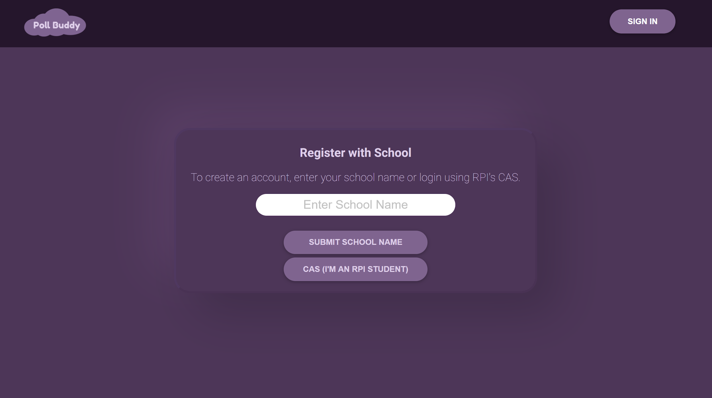
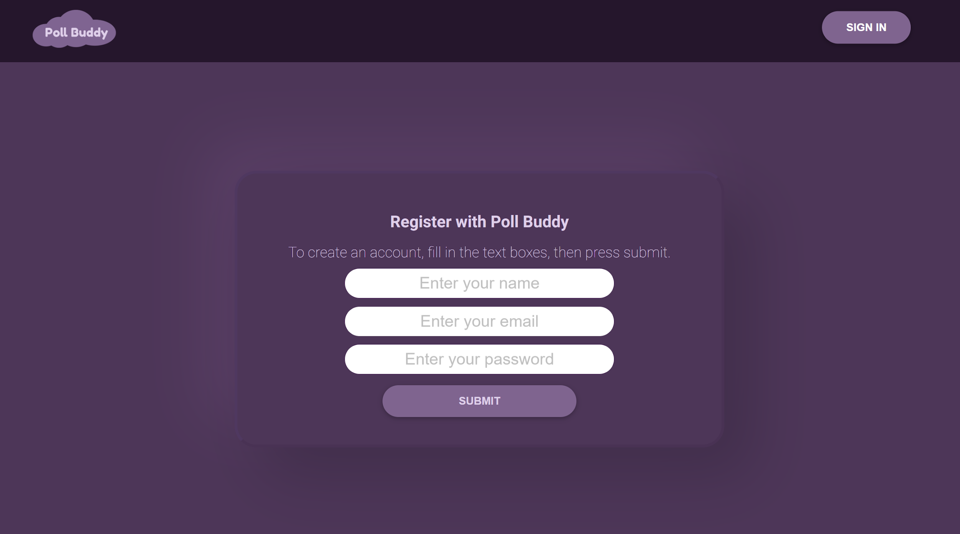
Register Pages
Register Homepage
Register with School
Register with Poll Buddy
Notes:
Presenter: Neha
Register pages - These are the three pages to register for an account. On the register homepage, you can either navigate to the register with school page or the register with poll buddy page. On the school page, there’s a place to insert your school name, or if you’re from RPI, then you can register through CAS. If you’re not from a school, then you can register with Poll Buddy by inserting your name, email and password.

Slide 17
Header
Notes:
Presenter: Annie
I’ve created a header component to be used on all, if not most, of the webpages. Currently, it contains a logo, title and button that links to a different page. Properties like page title, button type (sign in, sign up, account info) and it’s link can be set individually from the pages that use the header component. I’ve replaced all past versions of the header, that used to be implemented per page, in order to reduce redundancy in code and to promote consistency across all pages.

Slide 18
Ongoing Frontend Milestones
Month of April
Goal: Mostly complete UI
Goal: Frontend/Backend interaction
Month of May
Goal: Minimum viable product, beta version should be able to roll out Arch 2020
Future:
Coherency fixes, accessibility tweaks
More backend integration and dynamic functionality
Notes:
Presenter: Kevin Lee
Coherency fixes: same logo, font, colors, design choices, etc. everywhere
Accessibility Tweaks: Homepage thing bounces, needs to stop after a time period or be disabled basically, color contrast, font sizes, etc.
Dynamic Functionality: Making sure pages update with new data (like polls starting, updating), basically just pulling data from the backend and using it

Slide 19
Back End
Notes:
Alex

Slide 20




Backend Technologies
Docker
NodeJS
Express
MongoDB
Notes:
Alex
Here are the backend technologies that we are using
Each part of Poll Buddy runs in its own Docker container, frontend, backend, and the database
Docker is a container engine which allows you to run apps in an isolated environment without the overhead of virtual machines
Since everything is containerized it can be run on any machine with the Docker engine installed without having to worry about dependencies
In the containers we are using NodeJS, which is a platform for running JavaScript on the server side
It is asynchronous which makes handling different events easy and able to run in parallel
Easy to learn since JavaScript is already used on the frontend
With Node.js we’re using the Express framework
Frameworks make it easier to implement routes and different HTTP verbs, which is a pain to do in native Node.js
Data is stored in MongoDB, which is a NoSQL database where data is stored as JSON in collections and documents

Slide 21
Frontend-Backend Interaction
frontend
get
Database
fetch
Backend
post
Notes:
Joe Chu
Hi im Joe. I worked mostly in the backend and helped frontend utilize backend routes.
Frontend was able to successfully use backend get and post routes to retrieve and edit database content by calling a fetch command which accesses the route as specified in the backend. Its then passed through the backend to the frontend in json format to be parsed and displayed.
Code for asynchronous and dynamic data retrieval was implemented in the frontend to fix bugs with data retrieval specifically between components which are potentially initialized before given ID information on the group, user or poll

Slide 22
LocalStorage and Logins
Logout
no/null
Login Page
Home Page
Logged In?
yes/true
Login
Notes:
Joe Chu
Login functionality is implemented largely in the frontend but utilizes backend elements. The frontend queries a “localStorage” element in the frontend which holds the most recent state of whether the current browser is logged in or not and depending on the state of loggedIn, it redirects users to pages they have authentication for. During the Login action, the frontend fetches a POST request to the backend passing in login information. Upon authentication, the localStorage loggedIn state is set to true. During the Logout action, the localStorage loggedIn state is discarded and set to null. In the future this may be changed to accommodate multiple loggedIn states with different permissions to each.

Slide 23
Milestones
Month of February:
User routes
Month of March:
Starting on authentication/login system
Integration with the Frontend
Month of April:
Functional authentication/login system
Logging/Reporting system
Notes:
Joe Chu
In february, User routes were expanded to make it have similar creation, edit and get routes as groups and polls routes.
Initial implementation with the frontend and successful utilization of backend routes was achieved in march
In the near future we are working on better integration of the authentication and login systems as well as implementing other features such as logging/reporting system (graphs showing usage patterns, analytics, etc)

Slide 24
Back End Future Goals
Scaling
Submitty integration
Anti-cheating
And much more!
Notes:
Alex
Here are some of our future goals:
First off, scaling. We will need the application to be able to handle the load of large entry level CS courses.
We would like to integrate with Submitty for easier/automatic grading for professors
Since this is an online platform, anti-cheating functionality will be needed since it would be easy to answer questions from anywhere

Slide 25

Thank You!
Any Questions?
Individual Contributions List Here
Notes:
Hunter
This has been Poll Buddy! Graders, please also notice the link for contribution lists. Does anyone have any questions?

